Slide 1
Chapter 12
12-<number>

Slide 2
Supply Chains and the Value Delivery Network
Supply Chain
The sequence of processes involved in the production and distribution of a commodity.
Supply Chain Partners
Upstream partners include the set of firms that supply raw material, components, parts, information, finances, and expertise to create a product or service.
Downstream partners include the marketing channels or distribution channels that look forward toward the customer.
12-<number>

Slide 3
Supply Chains and the Value Delivery Network
Supply Chain Views
Supply chain “make and sell” view includes the firm’s raw materials, productive inputs, and factory capacity.
Demand chain “sense and respond” view suggests that planning starts with the needs of the target customer and the firm responds to these needs by organizing a chain of resources and activities with the goal of creating customer value.
The above two terms are limited and take a step-by-step, linear view of purchase-production-consumption activities
12-<number>

Slide 4
The Nature and Importance of Marketing Channels
Marketing Channel
A marketing channel (or distribution channel) is a set of independent organizations that help make a product or service available for use or consumption
The value delivery network is the firm’s suppliers, distributors, and ultimately, customers who partner with each other to improve the performance of the entire system.
12-<number>

Slide 5

The Nature and Importance of Marketing Channels
How Channel Members Add Value
Channel members add value by bridging the major time, place, and possession gaps that separate goods and services from those who would use them.
12-<number>

Slide 6
The Nature and Importance of Marketing Channels
How Channel Members Add Value
Producers use intermediaries because they create greater efficiency in making goods available to target markets.
Intermediaries offer the firm more than it can achieve on its own through their contacts, experience, specialization, and scale of operations.
From an economic view, intermediaries transform the assortments of products into assortments wanted by consumers.
  Producers – narrow assortments of products in large quantities
  Consumers – broad assortments of products in small quantities
12-<number>

Slide 7
The Nature and Importance of Marketing Channels
How Channel Members Add Value
Steps that help to complete transactions
Information: Gathering and distributing marketing research and intelligence
Promotion: Development and spreading persuasive communications about an offer
Contact: Finding and engaging customers and prospective buyers
Matching: Shaping and fitting the offer to the buyer’s needs, including activities such as manufacturing, grading, assembling, and packaging
Negotiation: Reaching an agreement on price and other terms of the offer so that ownership or possession can be transferred
Physical distribution: Transporting and storing goods
Financing: Acquiring and using funds to cover the costs of carrying out the channel work
Risk taking: Assuming the risks of carrying out the channel work
12-<number>

Slide 8
The Nature and Importance of Marketing Channels
Number of Channel Members
Channel level refers to each layer of marketing intermediaries that performs some work in bringing the product and its ownership closer to the final buyer.
  Direct marketing channel has no intermediary levels; the company sells directly to consumers.
  Indirect marketing channels contain one or more intermediaries.
From the producer’s point of view, a greater number of levels means less control and greater channel complexity
12-<number>

Slide 9
Channel Behavior and Organization
Channel Behavior
A marketing channel consists of firms that have partnered for their common food, with each member playing a specialized role.
Channel conflict refers to disagreement over goals, roles, and rewards by channel members.
  Horizontal conflict is conflict among members at the same channel level.
  Vertical conflict is conflict between different levels of the same channel.
12-<number>

Slide 10
Channel Behavior and Organization
Types of channel arrangements
  1) Conventional Distribution Systems
  Consist of one or more independent producers, wholesalers, and retailers.
  Each seeks to maximize its own profits and there is little control over the other members.
  No formal means for assigning roles and resolving conflict.
12-<number>

Slide 11
Channel Behavior and Organization
2) Vertical Marketing Systems
Vertical marketing systems (VMS) provide channel leadership and consist of producers, wholesalers, and retailers acting as a unified system
12-<number>

Slide 12
Types of Vertical Marketing System
  Corporate vertical marketing system integrates successive stages of production and distribution under single ownership e.g. ZARA.
  Contractual vertical marketing system consists of independent firms at different levels of production and distribution who join together through contracts to obtain more economies or sales impact than each could achieve alone. Most common form is the franchise organization
  Administered vertical marketing system has a few dominant channel members without common ownership. Leadership comes from size and power.
12-<number>

Slide 13
Channel Behavior and Organization
3) Horizontal Marketing Systems
Horizontal marketing systems include two or more companies at one level that join together to follow a new marketing opportunity.
Companies combine financial, production, or marketing resources to accomplish more than any one company could alone.
4) Multichannel Distribution Systems
Hybrid marketing channels exist when a single firm sets up two or more marketing channels to reach one or more customer segments.
E.g. Emirates airline
12-<number>

Slide 14
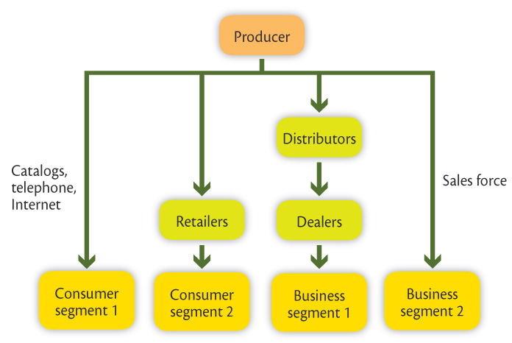
Channel Behavior and Organization
A multichannel distribution system
12-<number>

Slide 15


Channel Behavior and Organization
Hybrid Marketing Channels
Advantages
  Increased sales and market coverage
  New opportunities to tailor products and services to specific needs of diverse customer segments
Challenges
  Hard to control
  Create channel conflict
12-<number>

Slide 16
Channel Behavior and Organization
Changing Channel Organization
Disintermediation occurs when product or service producers cut out intermediaries and go directly to final buyers, or when radically new types of channel intermediaries displace traditional ones.
12-<number>

Slide 17
Channel Design Decisions
Analyzing Consumer Needs
Designing a channel system requires:
  Analyzing consumer needs
  Setting channel objectives
  Identifying major channel alternatives
  Evaluation
12-<number>

Slide 18
Channel Design Decisions
Analyzing Consumer Needs
Designing a marketing channel starts with finding out what target consumers want from the channel.
Setting Channel Objectives
in terms of:
Targeted levels of customer service
What segments to serve
Minimizing the cost of meeting customer service requirements
Objectives are influenced by
Nature of the company
Marketing intermediaries
Competitors
Environment
12-<number>

Slide 19
Channel Design Decisions
Identifying Major Alternatives
In terms of
  Types of intermediaries
  Number of intermediaries
  Responsibilities of each channel member
12-<number>

Slide 20
Channel Design Decisions
Identifying Major Alternatives
Types of intermediaries refers to channel members available to carry out channel work. Examples include
  Company sales force
  Manufacturer’s agency -are independent firms whose sales forces handle related products from many companies in different regions or industries.
  Industrial distributors
12-<number>

Slide 21
Channel Design Decisions
Identifying Major Alternatives
Number of marketing intermediaries to use at each level
    Intensive distribution - a strategy used by producers of convenience products and common raw materials in which they stock their products in as many outlets as possible.
    Exclusive distribution - a strategy in which the producer gives only a limited number of dealers the exclusive right to distribute products in territories, e.g. Luxury automobiles and High-end apparel
    Selective distribution - a strategy when a producer uses more than one but fewer than all of the intermediaries willing to carry the producer’s products, e.g., Televisions and Electrical appliances
12-<number>

Slide 22
Channel Design Decisions
Identifying Major Alternatives
Responsibilities of Channel Members - Producers and intermediaries need to agree on
  Price policies
  Conditions of sale
  Territorial rights
  Services provided by each party
12-<number>

Slide 23
Channel Design Decisions
Evaluating the Major Alternatives
Each alternative should be evaluated against
Economic criteria compares the likely sales costs and profitability of different channel members.
Control criteria refers to channel members’ control over the marketing of the product.
Adaptive criteria refers to the ability to remain flexible to adapt to environmental changes.
12-<number>

Slide 24
Channel Design Decisions
Designing International Distribution Channels
Channel systems can vary from country to country.
Must be able to adapt channel strategies to the existing structures within each country.
12-<number>

Slide 25
Channel Management Decisions
Channel management involves
  Selecting channel members
  Managing channel members
  Motivating channel members
  Evaluating channel members
12-<number>

Slide 26
Channel Management Decisions
Selecting Channel Members
Selecting channel members involves determining the characteristics that distinguish the better ones by evaluating channel members
  Years in business
  Lines carried
  Profit record
12-<number>

Slide 27
Channel Management Decisions
Selecting Channel Members
Selecting intermediaries that are sales agents involves evaluating
  Number and character of other lines carried
  Size and quality of sales force
Selecting intermediates that are retail stores that want exclusive or selective distribution involves evaluating
  Store’s customers
  Store locations
  Growth potential
12-<number>

Slide 28
Channel Management Decisions
Managing and Motivating Channel Members
Partner relationship management (PRM) and supply chain management (SCM) software are used to
  Forge long-term partnerships with channel members
  Recruit, train, organize, manage, motivate, and evaluate channel members
12-<number>

Slide 29
Channel Management Decisions
Managing and Motivating Channel Members
The company must sell not only through the intermediaries but also to and with them
Methods to motivate channel partners are:
  Develop a cooperative/collaborative and balanced relationship with the partner
  Understand the partner’s customers – their needs, wants, and demands
  Understand the partner’s business – operationally and financially and what’s really important to them
  Look at the partner’s needs in terms of customer support, technical support, and training
  Establish clear and agreed upon expectations and goals
  Develop recognition programs focusing on the partner’s contributions
  Build internal support systems and dedicate resources to the partner
12-<number>

